Slide 1

IWIC Application
Mobile and Web Development

Slide 2

What we showed you last time?

Slide 3
Iwic events API
User interface
Payment methods
Working LOGIN page
Detailed Software Tracking
This Photo by Unknown Author is licensed under CC BY-SA

Slide 4
Progress So Far

Slide 5
Continuity to design using provided content
Actually pulling from Event bright
Show working examples

Slide 6
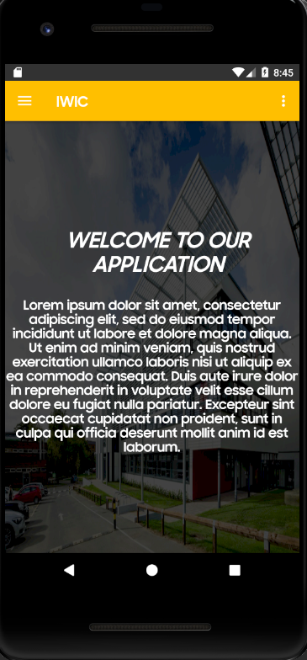
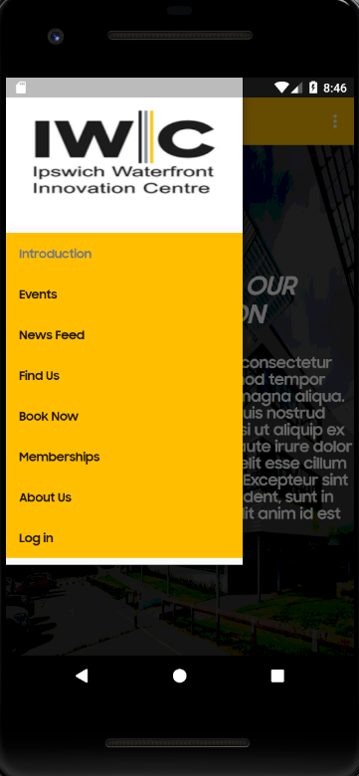
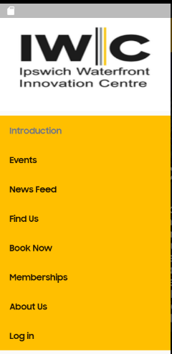
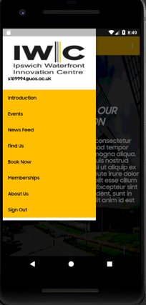

Slide 7
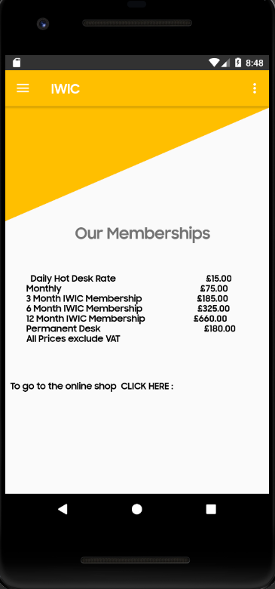
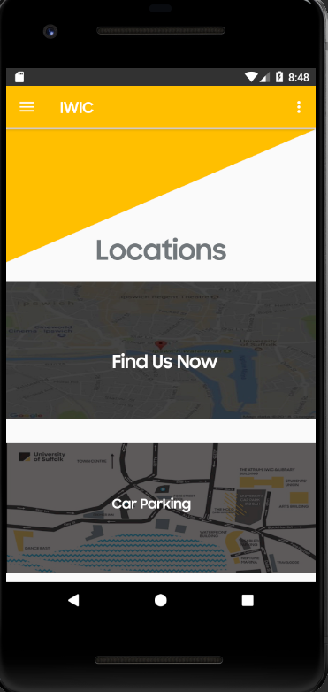

Slide 8
Guest account
Navigation bar
Memberships Page
Member Account
Introduction Page

Slide 9
What should you expect from us?

Slide 10
Content organization
Profiles page
Prioritize information
Useful links implementation

Slide 11
Demo of the working application
New meeting Wednesday 5th Dec

Slide 12
Any questions?
Thank you for your time.

